Slide 1

Problem Statement and Team Details
Problem Statement: Smart Doc Checker
Team Name: Net Ninjas
Team Leader Name: Masetti Manasvini
Institute Name: KL Deemed To Be University
Team Leader Email ID: mashettimanasvini@gmail.com

Slide 2
Problem and Solution
Problem:
Organizations, from colleges to large companies, manage numerous documents like rules, contracts, and guidelines. Over time, these documents develop contradictions, such as conflicting submission deadlines (10 PM vs. midnight) or different notice periods (2 weeks vs. 1 month). Manually checking for these conflicts is tedious, prone to errors, and can lead to disputes, penalties, and widespread confusion.
Solution:
We propose the Smart Doc Checker, an AI-powered agent designed to solve this problem. Our objective is to build a tool that allows users to:
Upload multiple documents.
Automatically detect contradictions and overlaps.
Receive suggestions for clarifications and resolutions.
Monitor external sources for updates that could create new conflicts.
Generate clear reports with a simple, usage-based billing model.

Slide 3
Methodology & Implementation
Our Approach
We are creating an AI-powered web app with a simple, user-friendly dashboard.
Core Features:
Upload Multiple Documents – Works with PDF, Word, and even images (via OCR).
Conflict Detection – AI finds contradictions and explains them clearly.
Reports – Auto-generates downloadable PDF/Word reports with conflicts and fixes.
Usage & Billing – Tracks usage and bills per document/report with Flexprice.
External Monitoring – Pathway checks external policy pages for updates and re-analyzes.
Advanced Features:
Severity Levels – Conflicts are marked as High, Medium, or Low.
AI Suggestions – Provides standard fixes for common issues.
Conflict Map – Interactive view of overlapping content between documents.
Smart Alerts – Notifies users via Slack, Email, or WhatsApp when new conflicts appear.

Slide 4
Technology Used
React – Builds the single-page application (SPA) using reusable components and hooks (useState, useEffect) for managing state and data flow.
Tailwind CSS – A utility-first CSS framework that makes designing layouts, styling, and responsiveness faster and more consistent.
Framer Motion – Provides animations like smooth transitions, fade-ins, and element movement to improve user experience.
JavaScript (ES6+) – The core programming language of the app, using modern features (arrow functions, async/await) to make code cleaner and efficient.
SVG Icons – Resolution-independent icons that scale on any device and can be easily styled for a professional UI.

Slide 5
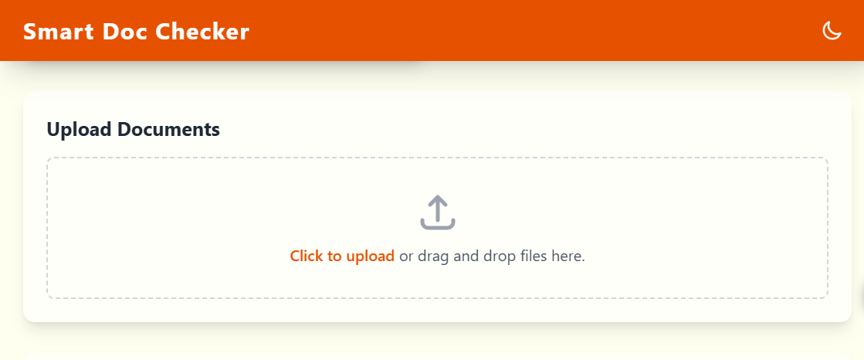
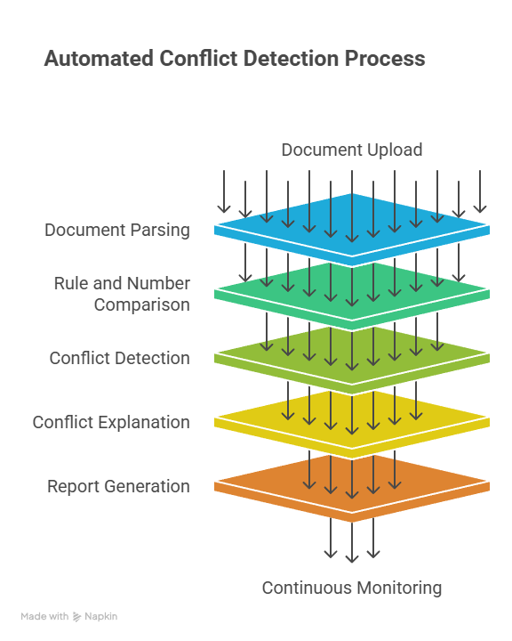
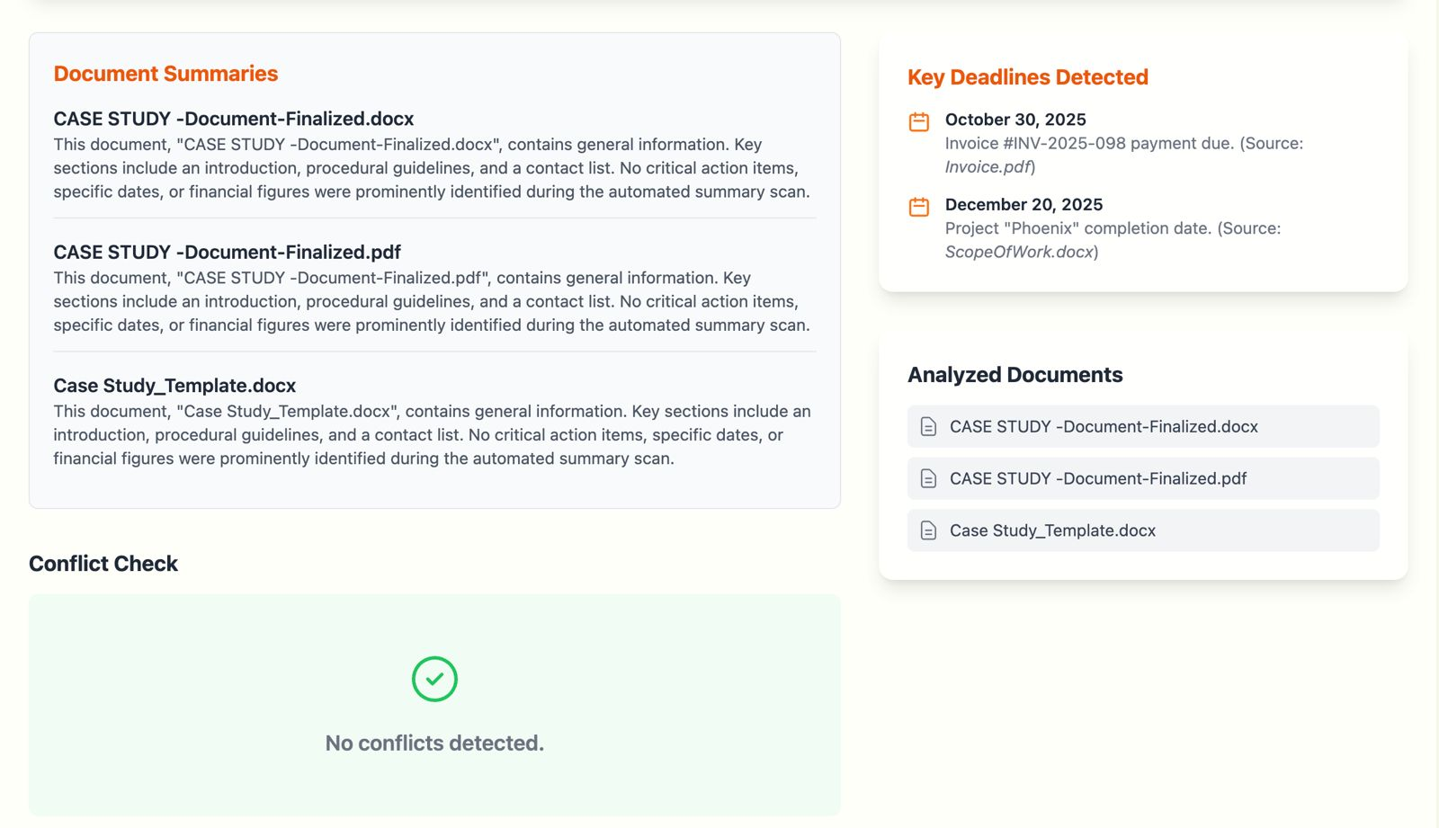
Flowchart & Supporting Images

Slide 6
GitHub Link:
ZenHarsha/-HackWithHyderabad-KLH
Demo video of our website:
https://drive.google.com/file/d/14tTExXAprd11qyqIBgpciFSEp5uOAEvf/view?usp=sharing

Slide 7
Feasibility and Market Use
Feasibility & Uniqueness
Our solution is highly feasible, leveraging a modern tech stack to meet all evaluation criteria. What makes our solution unique is that it doesn't just find problems—it helps solve them. Key differentiators include:
Proactive, not Reactive: Real-time monitoring and notifications.
Actionable Insights: Provides AI-powered resolutions and severity ranking.
Clarity: A visual conflict map makes complex issues easy to understand.
Multilingual Support: Essential for the diverse Indian market.
Market Use & Real-World Impact
Colleges: Reduce student disputes by ensuring circulars are consistent.
Companies: Align HR handbooks, legal contracts, and project guidelines.
Startups: Maintain policy consistency and save valuable time.
Government & Enterprises: Improve compliance tracking and avoid penalties.

Slide 8
Conclusion
Smart Doc Checker – AI Compliance Assistant
Smart Doc Checker is more than a contradiction finder — it’s a proactive compliance tool that keeps your documents consistent and risk-free.
Early Detection – Flags contradictions, overlaps, and gaps before they cause confusion or disputes.
AI Suggestions – Recommends clear, standardized resolutions to fix conflicts.
Real-Time Monitoring – Tracks external policy updates and re-checks automatically.
Visual Dashboard – Shows conflicts with severity levels and an interactive map.
For Everyone – Ideal for colleges, startups, and enterprises to maintain policy clarity and compliance.

